Slide 1

Unsupervised Learning for Power Plant Energy Generation in the US: K-means Clustering in Python Vs ArcGIS
Cristian Noriega Monsalve, Blessing Austin-Gabriel, Ernest Chianumba, Rolih Ferdinand

Slide 2
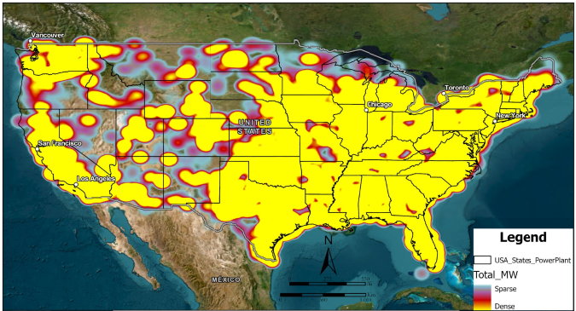
Data Set Visualization
Notes:
Data represents Power Plants across the U.S.
Pulled from ArcGIS Living Atlas Federal User Community
Regulated by federal departments and available for public consumption.

Slide 3
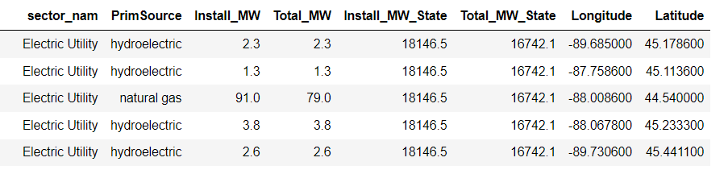
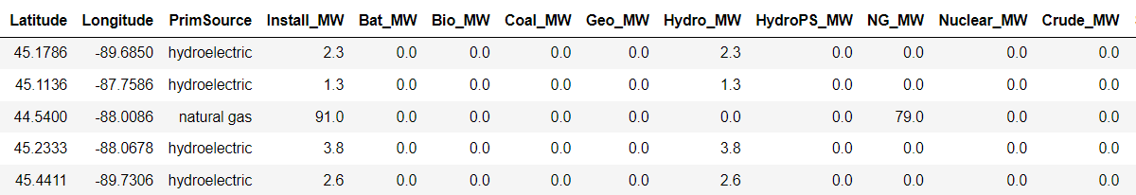
Data Set Description
Notes:
The data is broken down by Geographic location, fuel source, Total installed/max Cap, & individual fuel source capacity by site.
Contains 12,007 sites.

Slide 4






Preprocessing Techniques: Feature Selection & Standardization
Classification:
State
PrimSource
Regression:
Install_MW
Notes:
Preprocessing Techniques:
Categorical to numerical (Label Encoding)
Selection of relevant attributes
Using Install MW, Latitude, Longitude

Slide 5
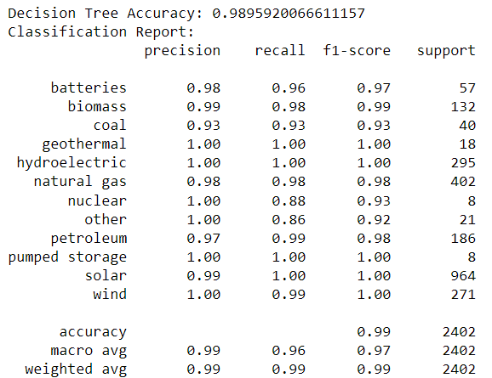

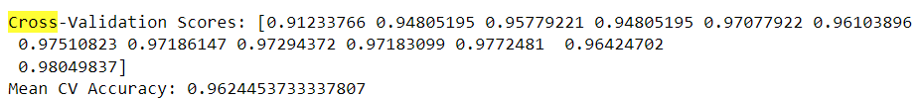
Machine Learning Technique: Decision Tree
Classification
Notes:
Machine Learning Technique: K-means Clustering:
Performed the elbow method to determine optimum values of k
Used values of 3, 5 & 7 to fit the data into visually correct values.

Slide 6
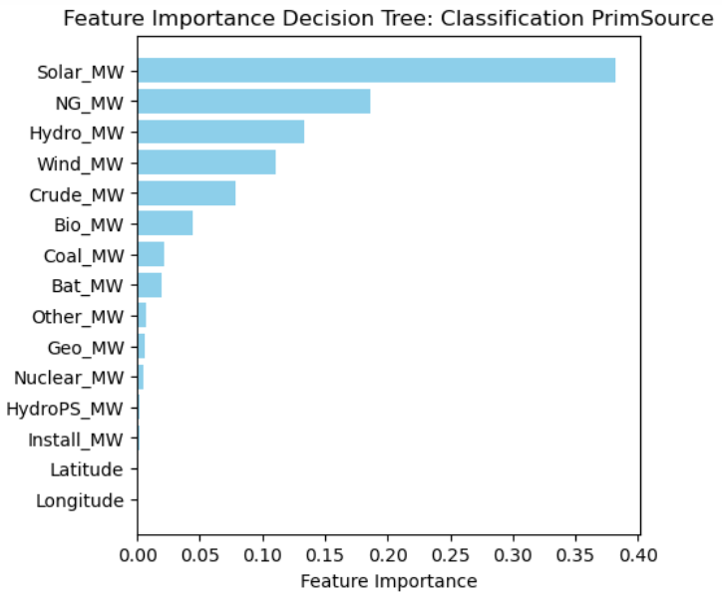
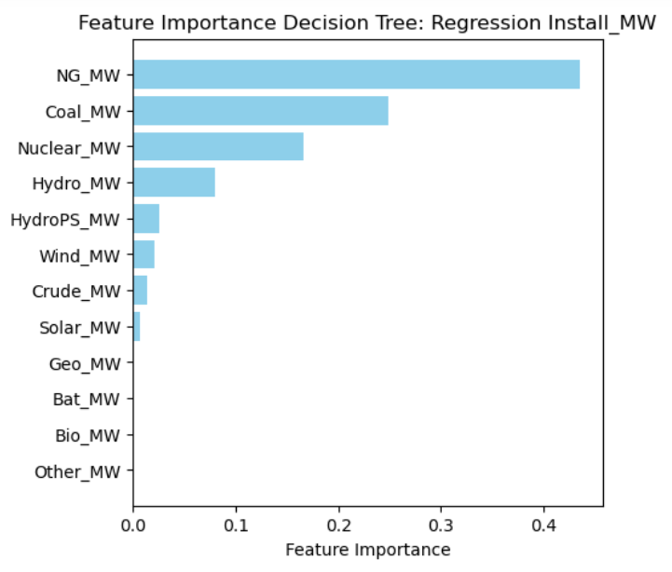
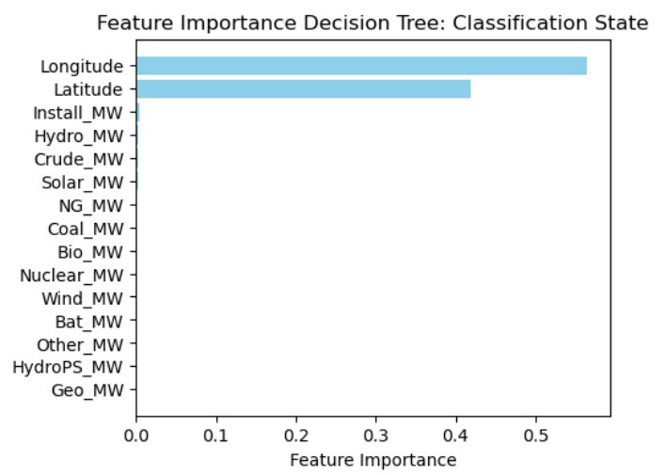
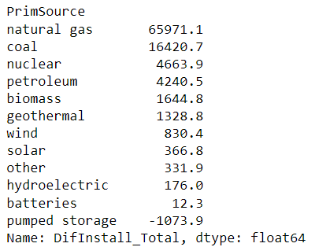
Machine Learning: Decision Tree

Slide 7
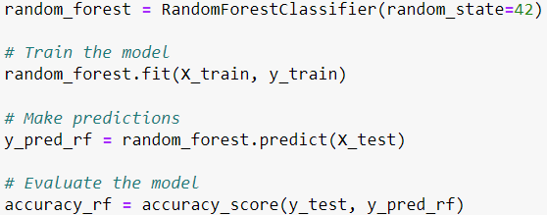
Machine Learning Technique: Random Forest
Classification PrimSource
Notes:
Machine Learning Technique: K-means Clustering:
Performed the elbow method to determine optimum values of k
Used values of 3, 5 & 7 to fit the data into visually correct values.

Slide 8
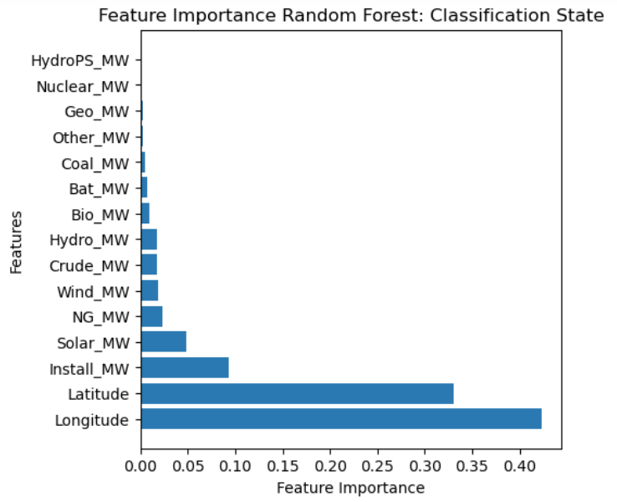
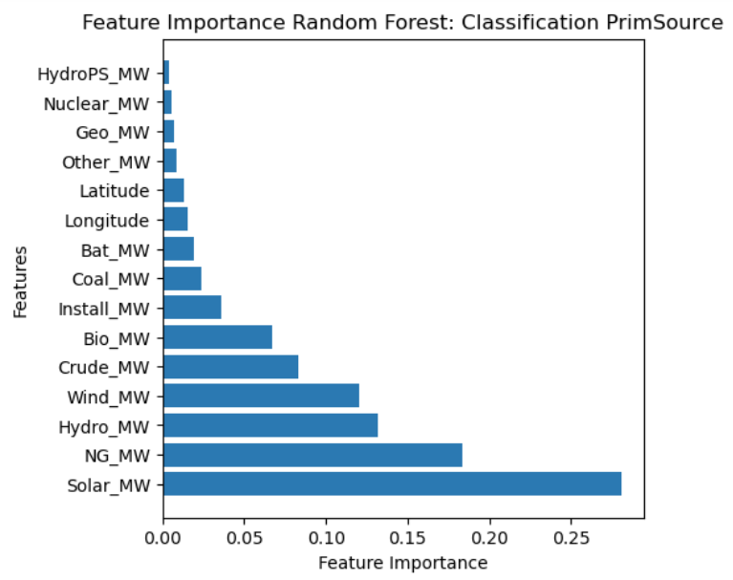
Random Forest: Feature importance

Slide 9
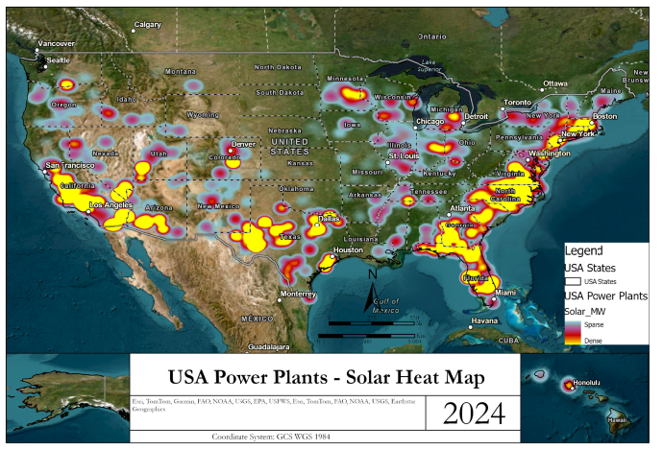
Solar

Slide 10
Cluster Analysis Conclusion
We learned that different types of preprocessing can be utilized to perform a variety of further analysis especially depending on the type and variety of data that is collected.
Using power plants gives a wide range of initial attributes.
These visualizations provided insights into:
How power plants are geographically grouped based on the energy source capacities and location.
The variability in power capacity among different clusters.
Potentially indicating specialization or focus on a particular energy source in certain regions or by certain types of power plants.
We learned that different techniques of preprocessing and selecting different features can perform different varieties of analyses, to yield different insights, especially depending on the type and variety of data that is collected.
Using power plants gives a wide range of initial attributes.
Once K values are determined even if using the optimum value (i.e. 3) doesn’t translate to accurate clusters. So we played around with different values until we got a proper fit. The best fit from my perspective came with the value of k=7.
ArcGIS Pro has a tool called Multivariate Clustering that we were able to use and compare to our python results and performs other combination of attributes to see how ArcGIS would perform its own clustering.
Notes:
Cluster Analysis & conclusions:
We learned that different types of preprocessing can be utilized to perform a variety of further analysis especially depending on the type and variety of data that is collected.
Using power plants gives a wide range of initial attributes.
Once K values are determined even if using the optimum value (i.e. 3) doesn’t translate to accurate clusters. So we played around with different values until we got a proper fit. The best fit from my perspective came with the value of k=7.

Slide 11
References
https://montclair.maps.arcgis.com/home/item.html?id=b063316fac7345dba4bae96eaa813b2f (US Power Plants Data source)
https://pro.arcgis.com/en/pro-app/latest/tool-reference/spatial-statistics/multivariate-clustering.htm (ArcGIS - Multivariate Clustering Tool)

